Slide 1
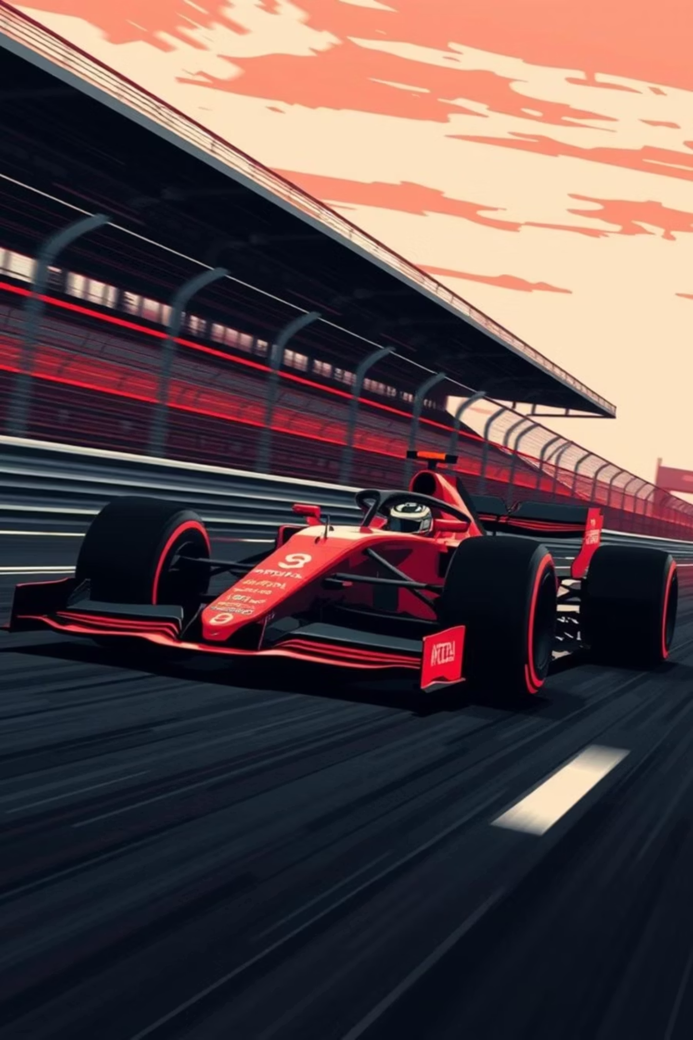

Formula 1 Performance Analysis & Race Outcome Prediction System
Prepared By: Uroosh Maryam (2024650), Emaan Fatima (2024154)
Instructor: Aamir Khan Maroofi

Slide 2


Project Overview & Objectives
Our project, "Pit Stop Crew AI," developed a robust software system to analyze historical F1 data (2022 season) and predict race outcomes using advanced Machine Learning (ML) techniques.
1
Modular Design
Design an OOP-based system for F1 data management.
2
Data Engineering
Clean, preprocess, and engineer time-series features from datasets.
3
Pure ML Model
Develop a Pure ML model for ordinal ranking race outcome prediction.
4
Interactive GUI
Create a Streamlit GUI for model tuning and visualization.

Slide 3

System Architecture: Object-Oriented Design
The system employs a modular, class-based design for high cohesion and maintainability, ensuring abstraction, reusability, and easy future expansion.
Driver/Team/Race Classes
Encapsulate F1 entities, statistics, and historical performance.
DatasetManager
Handles data loading, merging, and persistent storage.
Preprocessor
Manages data cleaning and time-series feature engineering.
PredictionModel
Trains and evaluates the LightGBM classifier.
Analyzer Class
Generates high-level analytical insights and visualizations for the GUI.

Slide 4
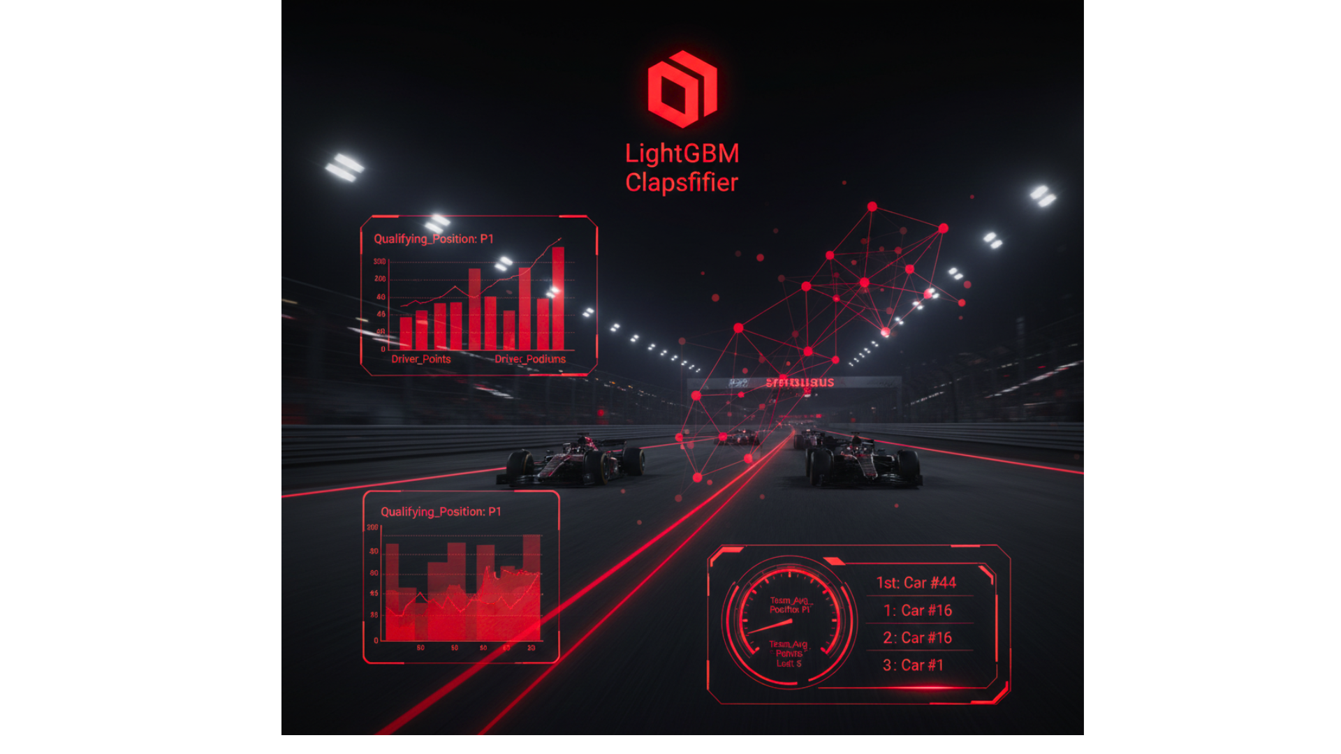


Methodology: Pure Machine Learning Approach
We treated race order prediction as an Ordinal Ranking Task using a LightGBM Multi-Class Classifier, ideal for structured, tabular data.
Model Selection
Feature Engineering
LightGBM Multi-Class Classifier for ordinal ranking (1st-20th positions).
Engineered features replace subjective bias, preventing data leakage with time-series sorting and lagging.
Critical Features
Past Performance: Driver_Points, Driver_Podiums
Race Context: Qualifying_Position (most predictive)
Car Form: Team_Avg_Points_Last_5 (rolling average)

Slide 5

Results and Analysis: Interactive GUI
The Streamlit GUI provides interactive model tuning and prediction analysis, highlighting key insights from the 2022 season.
Race-Specific Prediction
Cumulative Predicted Points
Predicted Podium Share
Visualizes the predicted frequency of podium finishes for top drivers, offering an overview of consistency.
Displays predicted finishing order (1st-20th) for any selected race round, resolving ties for definitive results.
Tracks predicted total championship points, demonstrating the model's ability to learn top team dominance.

Slide 6





Conclusion & Future Work
The Pit Stop Crew AI project successfully met its objectives, creating a robust, data-driven, and modular Pure ML system for F1 race prediction.
Hyperparameter Optimization
Implement automated search techniques (e.g., Grid Search) to maximize predictive accuracy.
Advanced Loss Functions
Utilize Learning-to-Rank (LTR) loss functions (like NDCG) to optimize prediction order.
Real-Time Integration
Incorporate near-real-time data (e.g., live sector times, weather) for dynamic in-race strategy advice.

